Slide 1
R Training

Slide 2
Content
DATA SOURCES: GETTING DATA FROM DATABASES, WEB, XML AND JSON IN R
RESHAPING DATA, SUB-SETTING OBSERVATIONS & VARIABLES, SUMMARIZING DATA
BUILDING A DASHBOARD - SHINY

Slide 3
DATA SOURCES: GETTING DATA FROM DATABASES, WEB, XML AND JSON IN R

Slide 4
Downloading files
Always check and set your working directory using the getwd() and setwd()commands
To check whether the “Data” directory has been created or not:
if (!file.exists("data")){ dir.create("data")
}

Slide 5
Read Excel file
> install.packages("readxl") or
> install.packages("devtools")
> devtools::install_github ("tidyve rse/readxl")
TIPS: You will be given a CSV file during Further Assessment stage, good luck =)

Slide 6
Read Excel File
Load the readxl library
> library(readxl)
Read built-in example excel files
> xlsx_example <- readxl_example("datasets.xlsx")
> read_excel(xlsx_example)

Slide 7
Read Excel File
read_excel()
reads both xls and xlsx files
and detects the format from the extension.
List the sheet names with excel_sheets()
> excel_sheets(xlsx_example)
Open specific sheet names.
> read_excel(xlsx_example,sheet = "chickwts")
> read_excel(xls_example, sheet= 4)

Slide 8
Read Excel File
Reading n number of rows
> read_excel(xlsx_example,n_max = 3)
Reading specific range
> read_excel(xlsx_example, range = “C1:E4”)
> read_excel(xlsx_example, range = cell_rows(1:4))
> read_excel(xlsx_example, range = cell_cols("B:D"))

Slide 9

Read MySQL
mySQL is a free and widely used open source database software
use library(RMySQL)

Slide 10
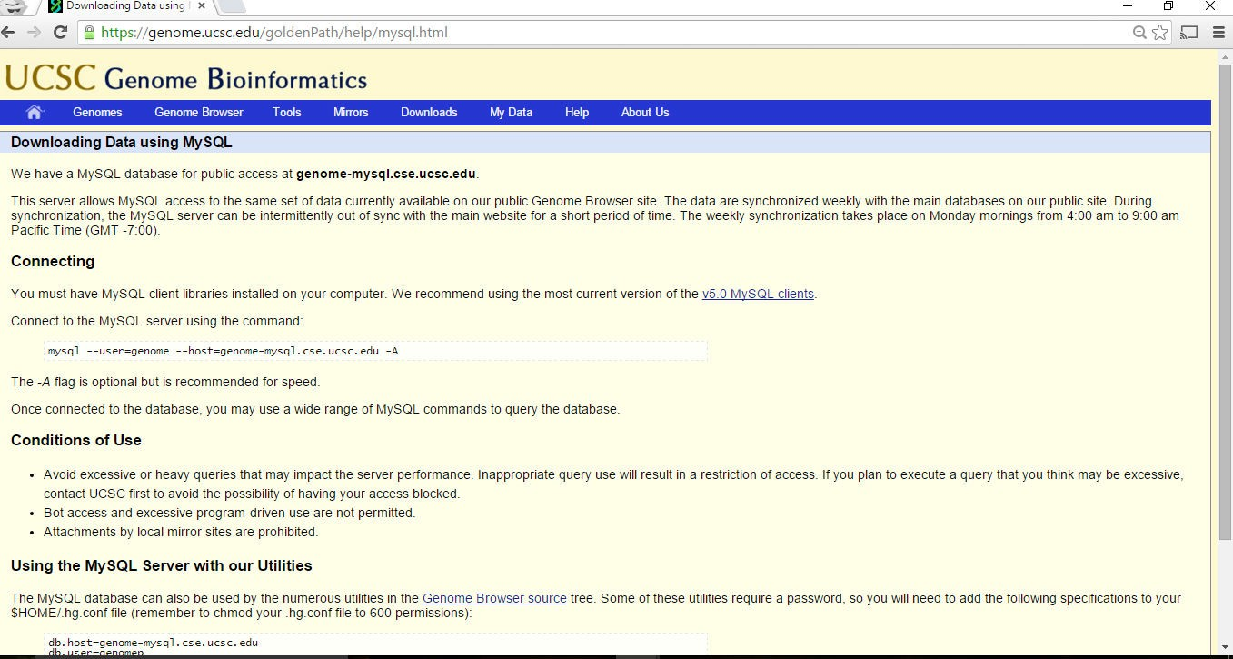
UCSC MySQL

Slide 11
Demo (connect and read tables)
Connect to UCSC Genome Online MySQL databases
List all the databases
Connect to “hg18” database
List all the tables in “hg18” database
Show tables 1 to 5
List all the fields for “HInvGeneMrna" table”
Select all from “HInvGeneMrna" table where “qNumInsert is between 2 and 3”
Show the result

Slide 12
Basic RMySQL commands
ucscDb<-dbConnect(MySQL(), user="genome", host="genome-mysql.soe.ucsc.edu") #to connect to MySQL with username and password
dbGetQuery #execute and fetch SQL queries
dbListTables #list all tables
dbListFields #list all fields for table
dbReadTable #read content from table
dbSendQuery #execute SQL queries
dbDisconnect #disconnect connection

Slide 13
Read from the Web
Webscraping - programatically extracting data from the HTML code of websites
Use readLines() or parsing with XML
Use GET from the httr package
Websites with password, you are required to provide username and password
Use handles

Slide 14
Downloading files
download.file() to download a file from the Internet
Important parameters are
url, destfile, method
For example download Apple shares price from quotemedia Finance
URL1 <- 'https://app.quotemedia.com/quotetools/getHistoryDownload.csv?&webmasterId=501&startDay=02&startMonth=02&startYear=2002&endDay=30&endMonth=07&endYear=2018&isRanged=false&symbol=TSLA‘
download.file(URL1, destfile = ‘data/tesla.csv')
list.files("./data")

Slide 15
Downloading files
download.file(url,
destfile,
method, quiet = FALSE,
mode =
"wb", | cacheOK | = | TRUE,
extra | =
getOption("download.file.extra")
, ...)

Slide 16
Exercise
Download the data for “Jumlah penumpang yang dikendalikan mengikut lapangan terbang (tidak termasuk penumpang transit) di Malaysia pada tahun 2000 – 2015” from this URL:
http://www.data.gov.my/data/ms_MY/dataset/f72882f5-9954-47f1-aa64-4851bd12a69b/resource/29d366b0-bce7-46c6-8c44-74eed2506e94/download/penumpangmengikutlapanganterbangtidaktermasukpenumpangtransit.xlsx
Store in passengers.xlsx file

Slide 17
read.csv () and read.csv2 ()
read.csv and read.csv2 are identical to read.table except for the defaults.
They are intended for reading ‘comma separated value’ files (‘.csv’) or (read.csv2) the variant used in countries that use a comma as decimal point and a semicolon as field separator.
read.csv(file, header = TRUE, sep = ",", quote = "\"", dec = ".", fill = TRUE, comment.char = "", ...)
read.csv2(file, header = TRUE, sep = ";", quote = "\"", dec = ",", fill = TRUE, comment.char = "", ...)

Slide 18
Reading from XML
Extensible Markup Language
Frequently used to store structured data
Particularly widely used in Internet applications
Extracting XML is the basis for most web scraping
Components
markup - labels that give the text structure
Content - the actual text of the document
http://en.wikipedia.org/wiki/XML

Slide 19
Tags, elements and attributes
Tags correspond to general labels
Start tags <section>
End tags </section>
Empty tags <line-break />
Elements are specific examples of tags
<Greeting> Hello, World </Greeting>
Attributes are components of the label
<img src="khpoo.jpg" alt="instructor" />

Slide 20
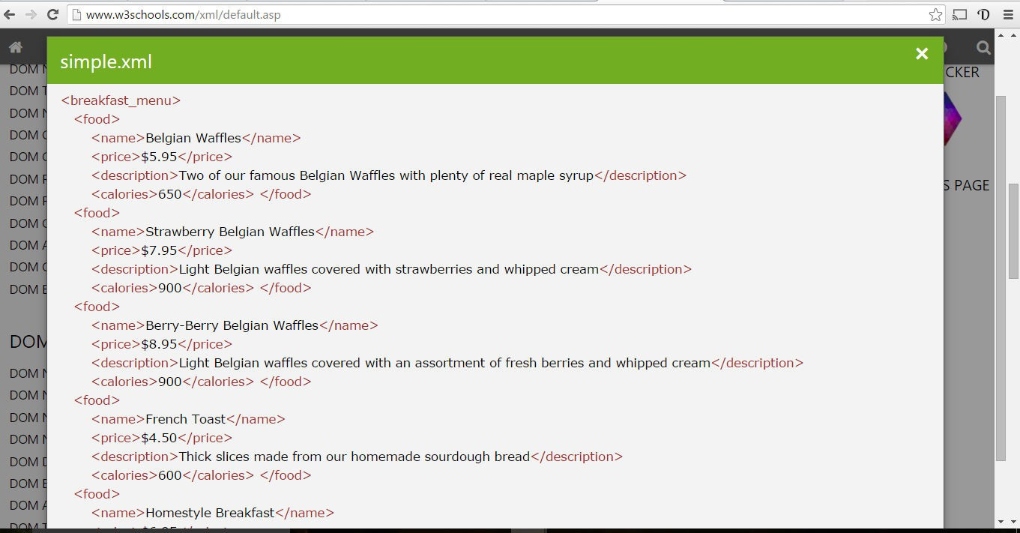
Example XML file

Slide 21
Read the XML file into R
install.packages('XML')
library('XML')
doc <- xmlTreeParse('./data/simple.xml', useInternalNodes = TRUE)
rootNode <- xmlRoot(doc)
rootNode
xmlName(rootNode)
names(rootNode)

Slide 22
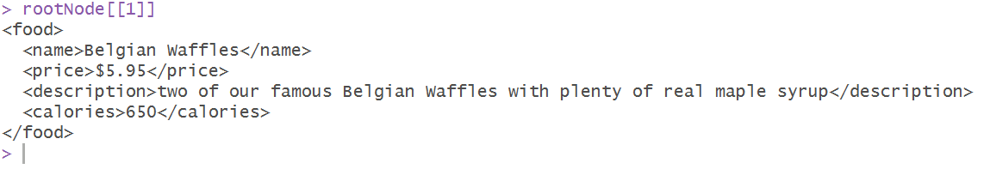
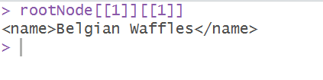
Directly access parts of the XML document
> rootNode[[1]]
> rootNode[[1]][[1]]

Slide 23
XPath
/node
Top level node Node at any level
//node
node[@attr-name]
attribute name
node[@attr-name='bob']
attribute with attr-name='bob'
Node with an
Node with

Slide 24
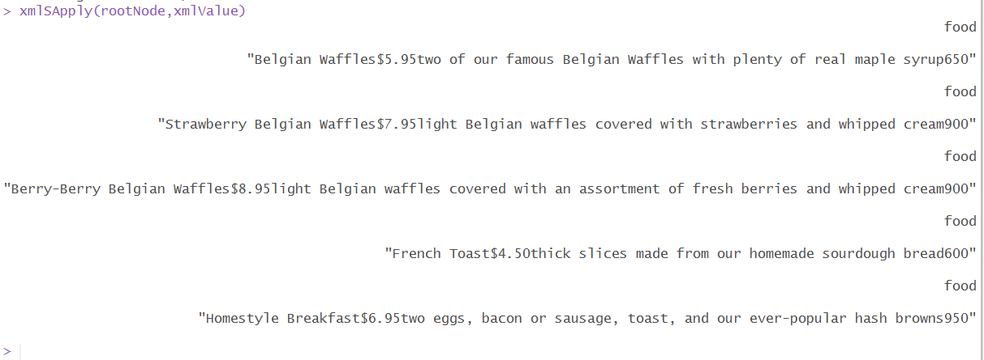
Programatically extract parts of the file
> xmlSApply(rootNode,xmlValue)

Slide 25
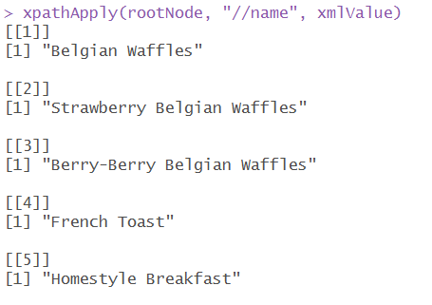
Get the items on the menu and prices
> xpathApply(rootNode,
"//name",
xmlValue)
> xpathApply(rootNode,
"//price",
xmlValue)

Slide 26
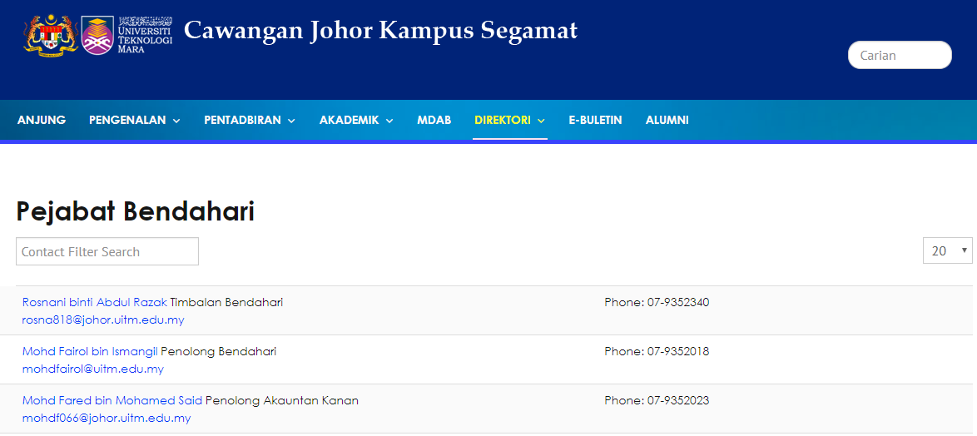
Example Webpage
https://johor.uitm.edu.my/v3/index.php/direktorij/pejabat-bendahari

Slide 27
Read from the Web
install.packages('XML')
require(XML) #for data crunching
con=url("https://johor.uitm.edu.my/v3/index.php/direktorij/pejabat-bendahari")
htmlCode=readLines(con)
close(con)

Slide 28
Exercise
Read the HTML content from this URL: https://johor.uitm.edu.my/v3/index.php/direktorij/pejabat-bendahari
Using htmlTreeParse function, find the the 1st name and phone number which appeared in the directory.
Looking for it Xpath would be usefull

Slide 29
Sample Answer
doc <- htmlTreeParse(htmlCode, useInternalNodes = TRUE)
trim <- function(x) gsub("^\\s+|\\s+$", "", x)
xpath <- "(//*[@id='adminForm']/ul/li[1]/div[1]/a | //*[@id='adminForm']/ul/li[1]/div[2]/text())"
txt <- trim(xpathSApply(doc,, xmlValue))
print(txt)

Slide 30
Reading JSON
Javascript Object Notation
Lightweight data storage
Use library (jsonlite) package
Structure similar to XML but different syntax/format
Read using the fromJSON
function and to
convert data into JSON, use the toJSON
function

Slide 31
Open JSON data
Navigate to the following url:
install.packages('jsonlite')
library (jsonlite)
url <- 'http://www.data.gov.my/data/ms_MY/dataset/b3a0b3cf-55c0-4926-9110-5c57703997ba/resource/df250753-335c-4022-9f82-03b7798d8c46/download/jumlah-pekerja-asing-plks-aktif-mengikut-sektor-2011---2016.json'
dt <- fromJSON(url)
class(dt)
dt

Slide 32
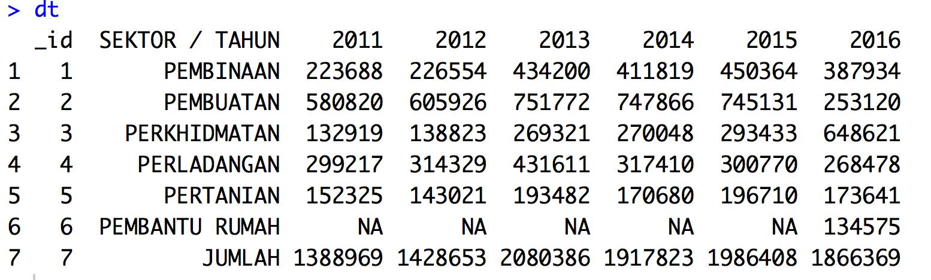
Open JSON data

Slide 33

Extracting node values
To extract the data for the column “2011”
> dt[['2011']]
To extract specific data from the column “2011”
> dt[['2011']][2]

Slide 34
RESHAPING DATA, SUB-SETTING OBSERVATIONS & VARIABLES, SUMMARIZING DATA
TIPS: Data preparation is the most important stage in model development….

Slide 35

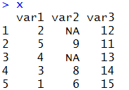
Sub-setting Data
Create some data
> set.seed(1)
> x <- data.frame("var1"=sample(1:5), "var2"=sample(6:10),"var3"=sample(11:15))
> x$var2[c(1,3)]=NA
> x

Slide 36
Subsetting Data: Hands-on
> x[,1]
> x[1:2, "var2"]
>
>
x[x$var1<=3 & x$var3 >10,] x[x$var1>2 | x$var3 >10,]
Task:
extract
all rows
with
"NA"

Slide 37

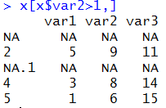
Subsetting Data: Hands-on
> x[x$var2>1,]
Data for var1 and var3 not presented correctly for row with NA

Slide 38


Subsetting Data: Hands-on
> x[which(x$var2>1),]

Slide 39


Subsetting Data: Hands-on
To retrieve row having maximum value for “var1”
> x[which.max(x$var1),]
>
Task: look
for row with
minimum
value for var3

Slide 40


Sorting Data
To sort values for a particular column
> sort(x$var1)
to sort decreasingly
> sort(x$var1,decreasing=TRUE)
What if I have “NA”
> sort(x$var2,na.last=TRUE)

Slide 41

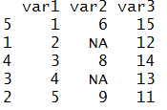
Sorting Data
How to sort the entire dataset based on a particular column, say “var1”?

Slide 42
Sorting Data: Hands-on
> x[order(x$var1),]
To sort data based on multiple columns,
> x[order(x$var1, x$var3),]

Slide 43
Sorting Data: dplyr package
> library(dplyr)
> | arrange(x, | var1)
> | arrange(x, | desc(var1))

Slide 44
Merging data
To perform an inner join by column “x”
> merge(dt.1, dt.2, by="x")
To perform an inner join by column “x” with either one matched,
> merge(dt.1, dt.2, by="x", all = TRUE)
To perform an inner join by column “x” and “y”
> merge(dt.1, dt.2, by=c("x","y"))

Slide 45
Merging data
Let’s create two data frames:
> set.seed(1)
> x<- sample(1:20,10)
> y<- sample(30:50,10)
> dt.1
<- data.frame(x,y)
> set.seed(2)
> x<- sample(1:20,10)
> y<- sample(30:50,10)
> dt.2
<- data.frame(x,y)

Slide 46
Exercise
Download the “Genting Malaysia Berhad” share prices (in csv) from quotemedia Finance (URL: https://app.quotemedia.com/quotetools/getHistoryDownload.csv?&webmasterId=501&startDay=02&startMonth=02&startYear=2002&endDay=30&endMonth=07&endYear=2018&isRanged=false&symbol=GMALF)
Store in genting.csv file
Read the file and describe the data obtained:
Number of observations
Number of Variables
Names of the variables
Calculate average closing price
Calculate number of days where the closing price is more than RM 1.35

Slide 47
Merging Data: Hands-on
df1<-data.frame(CustomerId = c(1:6), Product = c(rep("Honda",3), rep("Chevrolet",3)))
df2<-data.frame(CustomerId = c(2, 4,7), State = c("Selangor","Sarawak","Kelantan"))
How does the data frames look like?

Slide 48
Merging Data: Hands-on
Task 1:
Return only the rows in which the df1 have matching keys in df2.

Slide 49
Merging Data: Hands-on
Task 2:
Return all rows from the df1, and any rows with matching keys from df2.

Slide 50
Merging Data: Hands-on
Task 3:
Return all rows from the df2, and any rows with matching keys from df1.

Slide 51
Downloading a File
Go to http://data.gov.my/view.php?viewhttp://www.da ta.gov.my/data/ms_MY/dataset/senarai-lokaliti- hotspot-wabak-denggi-di-malaysia-2015 and download dengue hotspot for 2015
url<-"http://www.data.gov.my/data/dataset/b5cd948f- cffb-4439-ae08-e508ff073a93/resource/1f2d5629-ac8d- 449a-a4c1- 9d269d625d84/download/lokalitihotspot2015.xlsx"
download.file(url,"dengue.xlsx",mode='wb')

Slide 52


Downloading a File
Convert the file to CSV using Excel for ease of reading
> dt <- read.csv('dengue.csv')
Check the field names of the dataset
> names(dt)

Slide 53
Splitting data
What is the command to split data according to “Negeri”?
> dt.split.1<- split(dt, dt$Negeri)
What is the command to split “Jumlah.Kes.Terkumpul” according to “Negeri”?
> dt.split.2 <-
split(dt$Jumlah.Kes.Terkumpul,
dt$Negeri)

Slide 54
Splitting data
Apply a function across elements of the list,
> lapply(dt.split.2,
sum)

Slide 55
Splitting data
How to get the sum of Jumlah.Kes.Terkumpul for each Daerah.Zon.PBT?
> tapply(dt$Jumlah.Kes.Terkumpul, dt$Daerah.Zon.PBT, sum)

Slide 56

Column Name Manipulation
fixed=TRUE to make sure gsub treats “.” and a dot, not a function
Remove dot(.) in all the field names
> names(dt) <- gsub(".", "", names(dt), fixed=TRUE)
> names(dt)

Slide 57
Column Name Manipulation
To rename all the columns,
> names(dt) <- c("Year","Week","State","District","Locati on","Total","Outbreak Duration")
To rename a specific column only,
> names(dt)[2] <- 'Week No'
Check the changes to the columns

Slide 58
Column Name Manipulation
Replace all space the field names with “_”.
> names(dt)<-gsub("
", "_",
names(dt))

Slide 59
Records Manipulation
Inspect the data for location, you can see there are many wrong spellings. Say, if we want to replace “Tmn” to “Taman” for all data in Location
> dt$Location dt$Location)
<-gsub("Lndah",
"Indah",
Check the data first before replacing anything
Try replacing all “Kg” to “Kampung”

Slide 60


String split
The command = strsplit()
> strsplit("hello
Malaysia
!", " ")
To split a particular record based on a particular character in a dataset,
> strsplit(as.character(dt$Location),
" ")[[1]]

Slide 61

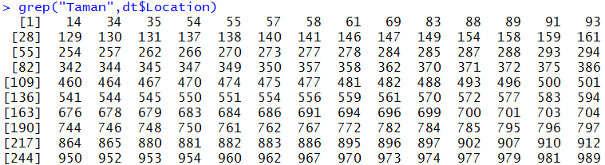
Finding Values
Say if we want to know how many times the word “Taman” has appeared in the “Location” field,
> | grep("Taman",dt$Location)
> | grep("Taman",dt$Location, | value=TRUE)
How many of them? What command to use?

Slide 62
Finding Values
How many with “Taman” and otherwise?
> cnt<-table(grepl("Taman",dt$Location))
> barplot(cnt)
What do you get? Explain…

Slide 63
Finding Values
Now, store all the data with the word “Taman” in Location in a variable named dt_Taman.
> dt_Taman
<- dt[grepl("Taman",
dt$Location),]
How many records in dt_Taman ?

Slide 64
Finding Values
Now, store all the data with the word “Seksyen” or “Medan” in Location
> dt[grepl("Seksyen|Medan",
dt$Location),]

Slide 65
Finding Values
Looking for any characters.
For example, we could retrieve locations that begins with the character “T” and contains character “1” from the “Location” column.
> dt[grep("^T(.*)1",
dt$Location),"Location"]

Slide 66
Hands-on
Look for all locations with the words “Jalan” and “Jaya”.
Retrieve all records with the word “Taman” in “Location” in the district “Petaling”.
How many “Kampung” in Selangor and Perak. Plot a graph to compare the two.
[estimation = 20 minutes]

Slide 67
data.table package
data.table can be considered data.frame as a set of columns
Every column is the same length but different type
Inherits from data.frame
All functions that work in data.frame will work with data.table
It is designed to work much faster for subsetting, group and updating
Goal 1: Reduce programming time
(fewer function calls less variable name repetition)
Goal 2: Reduce computation time
(fast aggregation, update by reference)

Slide 68
data.table general form
trades [
filledShares < orderedShares ,
sum ((orderedShares - filledShares) * orderPrice/fx) ,
by = "date,region,algo"
]
R: | i | j | by
SQL: | WHERE | SELECT | GROUP BY

Slide 69
Data.table general form
DT [i , j , by]
Easy to remember, just say "Take DT, subset rows using i, then calculate j grouped by by“
Once you grok the above reading, you don't need to memorize any other functions as all operations follow the same intuition as base.

Slide 70
Exercise
Compare both data.frame and data.table
> DF <- data.frame(x=rep(c("a","b","c"),each=3), y=c(1,3,6), v=1:9)
> DT <- data.table(x=rep(c("a","b","c"),each=3), y=c(1,3,6), v=1:9)
Notice the output differences for both DT and DF
Check the class for both DF and DT
Subsetting rows: Select row 3 to 5 and the output for DF and DT
Show all the records where x==a
Show records for rows 1,3,7 for both DF and DT

Slide 71
Exercise (Computing on Columns)
The subsetting function is modified for data.table
the argument passed after the comma is called an "expression“
Examples
>DT[,list(mean(y),
>DT[,.(length(x), list()
sum(v))]
sum(y))]
# .() is same as
Find the max for column y and mean for column v
Find the square root of column y and store in column w, show all the elements in w
Find the mean of column v and store in column w

Slide 72
Exercise (multiple operations)
Performs any expression on j
Example:
>DT[,plot(y,v)]
>DT[, for(x in 1:10) print(x)]
Plot the histogram for y and find the log value for elements in column v and store in a variable called temp and in column z

Slide 73
Exercise (Doing j by group)
Get the sum of v and group them by column x
> DT[,sum(v),by=x]
Calculate the mean for column y and group the result by even and odd rows
> library(datasets)
Load the iris data set, convert it to data.table called irisDT
Get the mean for Sepal.Width and group the results by Species

Slide 74
Exercise (Performance Analysis)
Determine the time to compute mean for Sepal.Length group by Species
fileURL10<- "https://raw.githubusercontent.com/vincentarelbundock/R datasets/master/csv/datasets/iris.csv"
download.file(fileURL10,destfile="./data/iris.csv")
irisDT<-fread("./data/iris.csv")
system.time(irisDT[,mean(Sepal.Length),by=Species])
Find the computation time for the followings:
system.time(mean(irisDT$Sepal.Length,by=DT$Species))

Slide 75
Building a dashboard - Shiny
1
TIPS: Further learning… you may not need a full dashboard to demonstrate your prediction..

Slide 76
Course Background
This course covers the basics of creating data products using Shiny, R packages, and interactive graphics.
The course will focus on the statistical fundamentals of creating a data product that can be used to tell a story about data to a mass audience.
Students will learn a variety of core tools for creating data products in R and R Studio in specific.

Slide 77
Learning Objectives
Towards the end of this lesson, you should be able to:
Describe the architecture of shiny app
Develop shiny app
Publish shiny app to shinyapps.io

Slide 78
What is Shiny?
Shiny is a platform for creating interactive R programs embedded into a web page.
Suppose that you create a prediction algorithm, with shiny you can very easily create web input form that calls R and thus your prediction algorithm and displays the results.
Using Shiny, the time to create simple, yet powerful, web-based interactive data products in R is minimized.
However, it lacks the flexibility of full featured (and more complex) solutions
Shiny is made by the folks at RStudio.

Slide 79
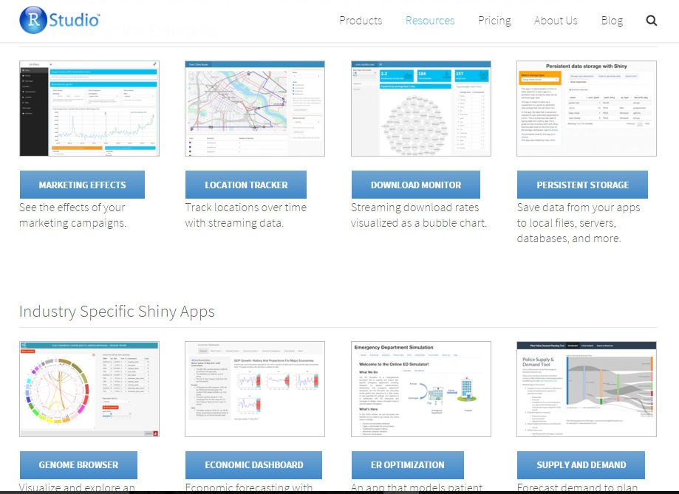
Shiny showcase
5
https://www.rstudio.com/ products/shiny/shiny-user- showcase/

Slide 80

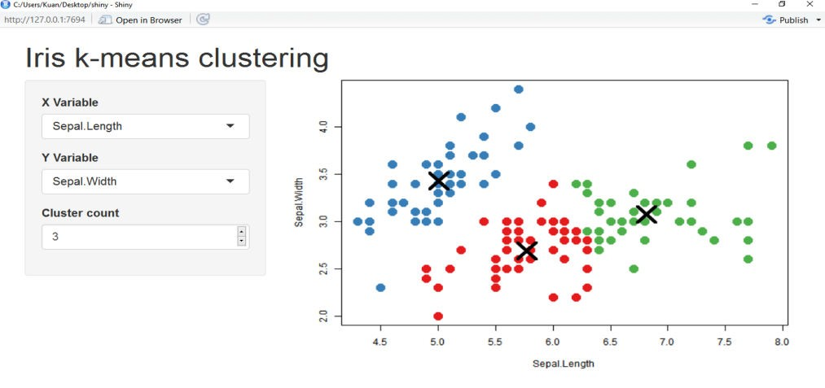



The architecture of Shiny
Every Shiny app is maintained by a computer running R
Server Instructions
User Interface (UI)

Slide 81
shinyapps.io
Shinyapps.io is a platform as a service (PaaS) for hosting Shiny web apps (applications).
Before you get started with shinyapps.io, you will need:
An R development environment, such as the RStudio IDE
(for Windows users only) RTools for building packages
(for Mac users only) XCode Command Line Tools for building packages
(for Linux users only) GCC
The devtools R package (version 1.4 or later)
The latest version of the rsconnect R package

Slide 82
Installation of devtools and rsconnect
devtools
Shinyapps.io uses the latest improvements to the devtools package. To use shinyapps.io, you must update devtools to version 1.4 or later. To install devtools from CRAN, run the code below. Then restart your R session.
> install.packages('devtools')
rsconnect
The rsconnect package deploys applications to the shinyapps.io service. You can do this by running the R command:
> install.packages('rsconnect')
After the rsconnect package has been installed, load it into your R session:
> library(rsconnect)

Slide 83
shinyapps package
Installation of shinyapps package:
To install, run this:
> install.packages('shiny')

Slide 84
Create a shinyapps.io account
Go to shinyapps.io and click “Log In.”
If you do not have an account, create a new account or sign in using your Google or github account
The first time you sign in, shinyapps.io prompts you to setup your account. Shinyapps.io uses the account name as the domain name for all your apps.
Once you set up your account in shinyapps.io, you can configure the rsconnect package to use your account.

Slide 85
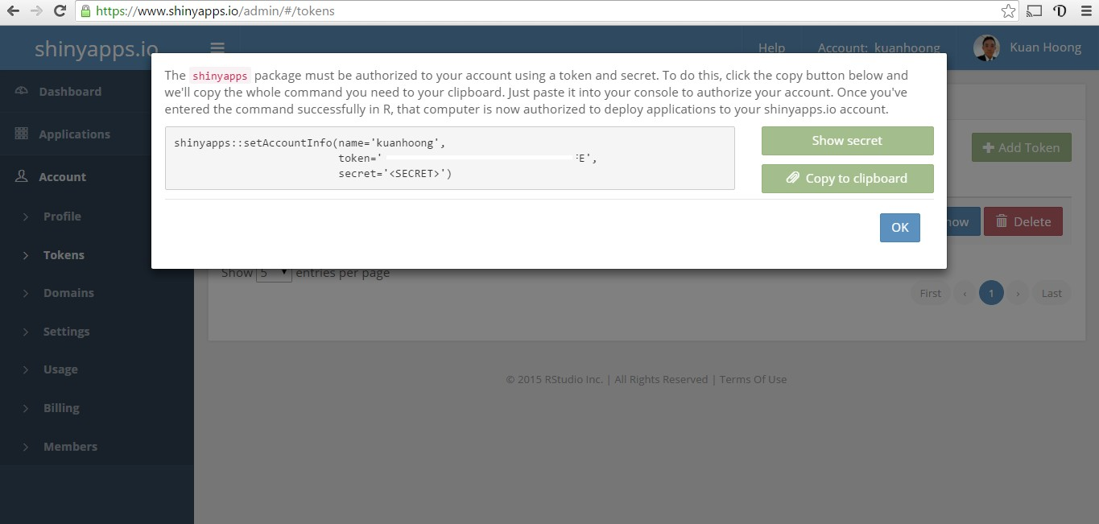
Configure the rsconnect package
Click the show button on the token page.
Copy the command to your clip board, and then paste it into the command line of RStudio and click enter.

Slide 86


App template
library(shiny) ui <- fluidPage()
server <- function(input, output) {} shinyApp(ui = ui, server = server)

Slide 87


Input and Output
Add elements to your app as arguments to fluidPage()
ui <- fluidPage(
#
#
*Input()
*Output()
functions, functions
)

Slide 88
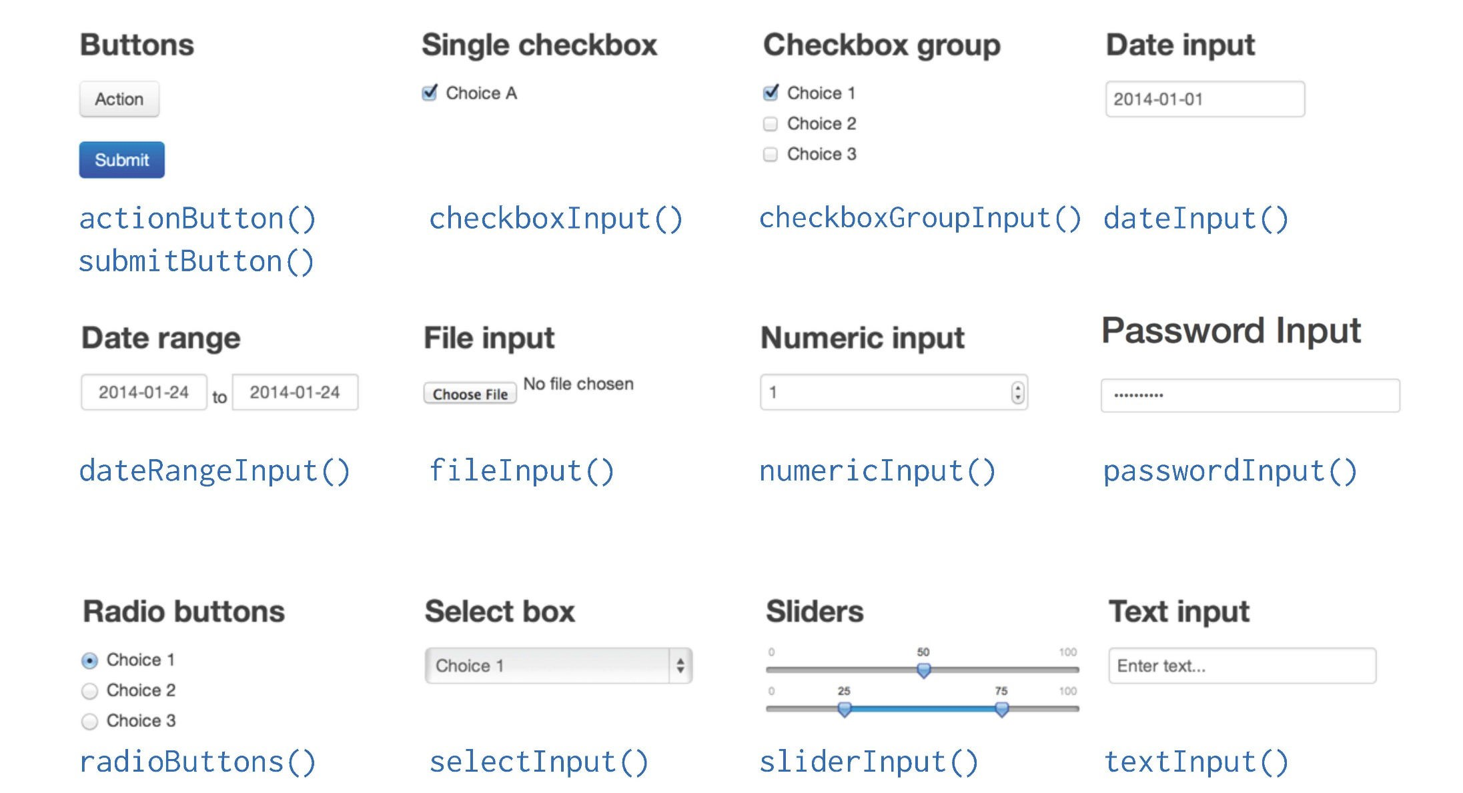
Input

Slide 89
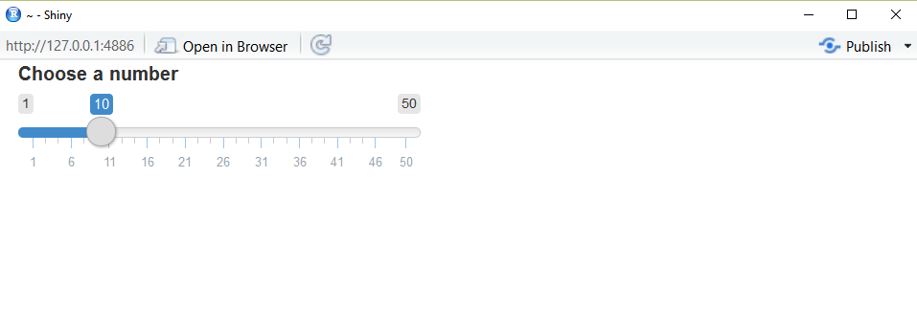
Create an Input with an Input() function
sliderInput(inputId = "num", label = "Choose a number", value=10, min = 1, max = 50)

Slide 90


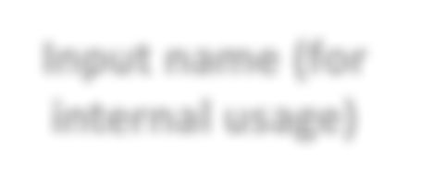
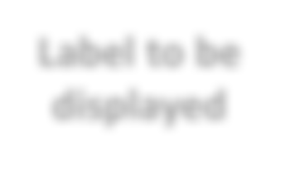

Input syntax
sliderInput(inputId
= "num",
label
= "Choose
a number", …)
Input name (for internal usage)
Label to be displayed
Specific arguments

Slide 91
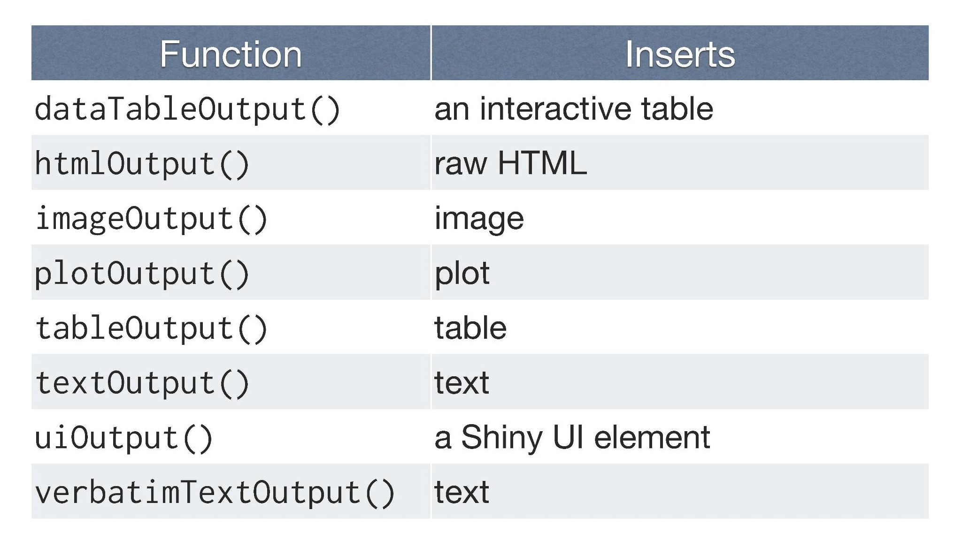
Output

Slide 92


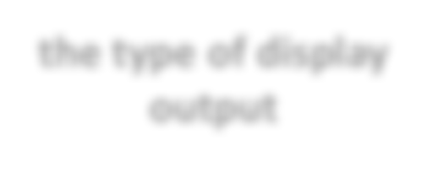
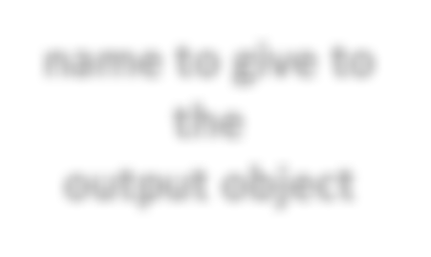
Output syntax
To display output, add it to fluidPage() with an *Output() function
plotOutput("hist")
the type of display output
name to give to the
output object

Slide 93
Server Function
Use 3 rules to write the server function
Save objects to display to output$
Build objects to display with render*()
Access input values with input$
Reactivity automatically occurs whenever you use an input value to
render an output object

Slide 94
Server function
Save objects to display to output$
server <- function(input, output) { output$hist <- # code
}
output$hist
plotOutput("hist")

Slide 95
Server function
Build objects to display with render*()
server <- function(input, output) { output$hist <- renderPlot({
})
}

Slide 96


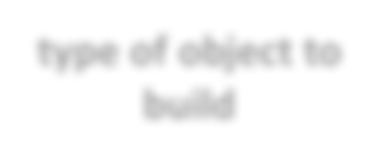
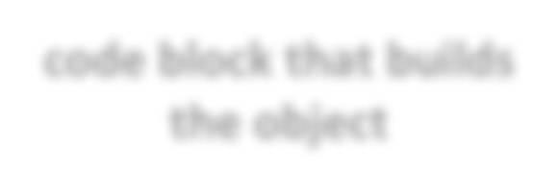
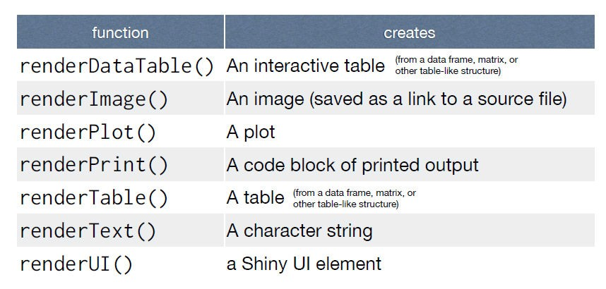
render() function
Use the render*() function that creates the type of output you wish to make.
renderPlot({ hist(rnorm(100)) })
type of object to build
code block that builds the object

Slide 97
Server function
Build objects to display with render*()
server <- function(input, output) { output$hist <- renderPlot({
title <- "50 random normal values" hist(rnorm(50))
})
}

Slide 98
Server function
Access input values with input$
server <- function(input, output) {
output$hist <- renderPlot({
hist(rnorm(input$num))
})
}
sliderInput(inputId = "num",…)
input$num

Slide 99
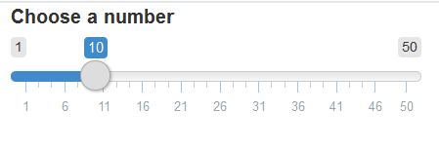
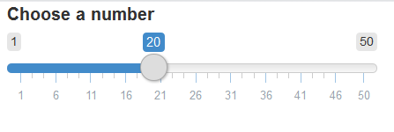
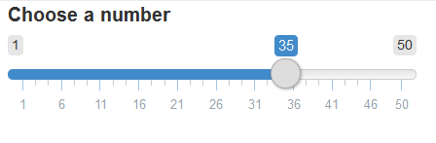
Input values
The input value changes whenever a user changes the input.

Slide 100

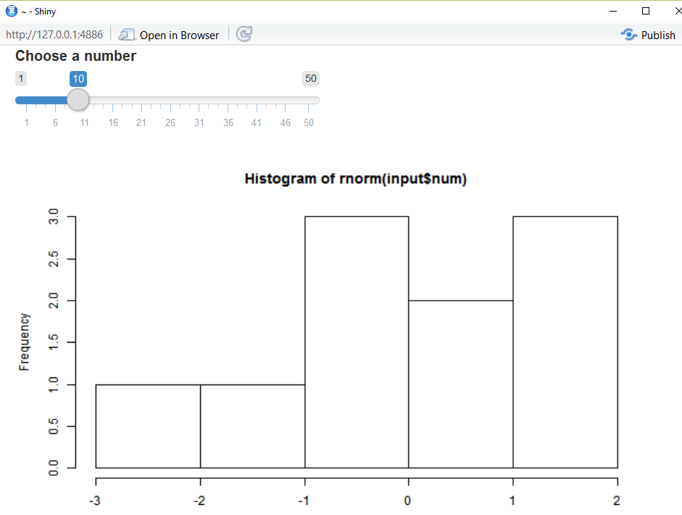


Reactivity in R as two steps process
1. Reactive values notify the functions that use them when they become invalid
input$num
2. The objects created by the reactive functions respond
renderPlot({ hist(rnorm(input$num))})

Slide 101
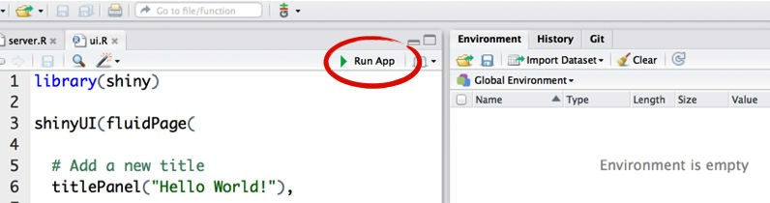
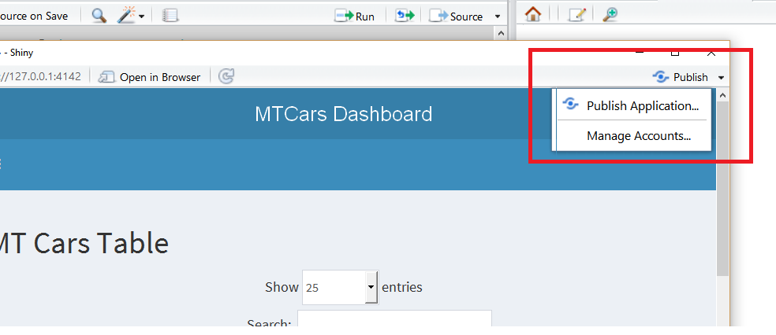
Running and Deploying apps
Make sure you have one directory with every file the app needs:
app.R (your script which ends with a call to shinyApp())
All your datasets, images, css, helper scripts, etc. in the same folder
To run your shiny app, click on the Run App button
Click on the publish button to submit your shiny app to shinyapps.io

Slide 102
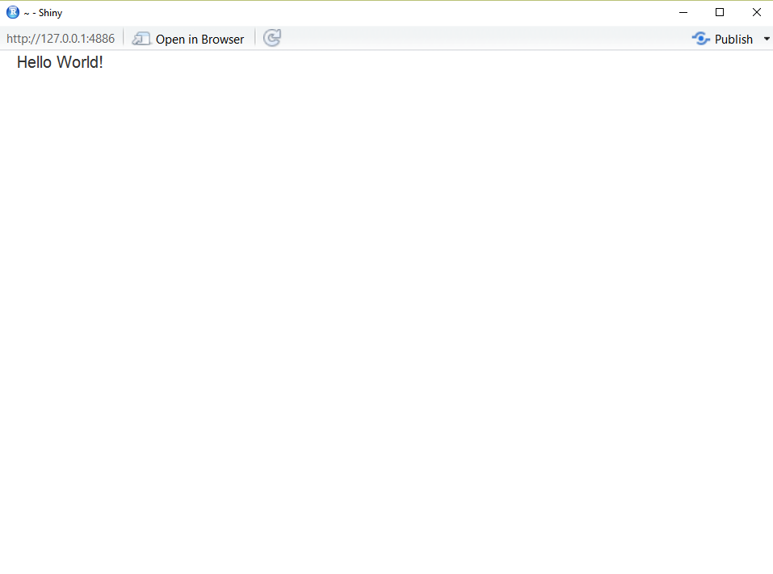
Exercise 1: Create first shiny page
library(shiny)
ui <- fluidPage("Hello World!") server <- function(input, output) {}
shinyApp(ui = ui, server = server)

Slide 103
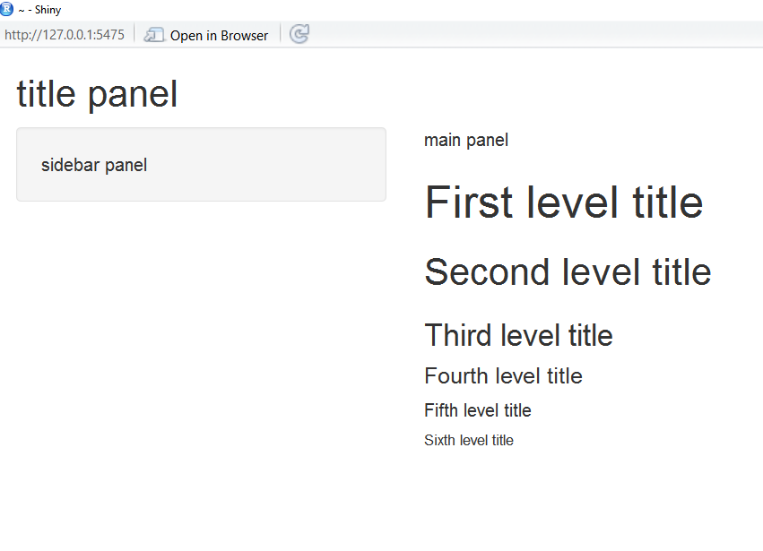
Exercise 2: Customize your shiny page
library(shiny) ui <- fluidPage(
titlePanel("title panel"), sidebarLayout(
sidebarPanel( "sidebar panel"), mainPanel("main panel",
h1("First level title"))
)
)
server <- function(input, output) {} shinyApp(ui = ui, server = server)

Slide 104
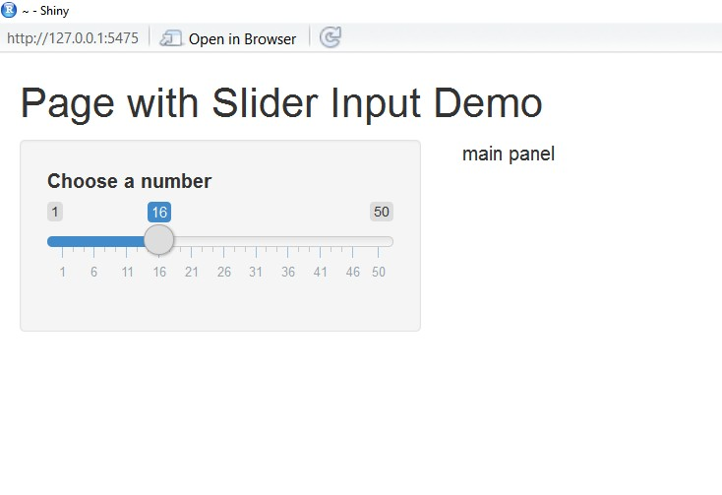
Exercise 3: Add Input and Output
library(shiny) ui <- fluidPage(
titlePanel("Page with Slider Input Demo"), sidebarLayout(
sidebarPanel(
sliderInput(inputId = "num",label = "Choose a number", value = 10, min = 1, max = 50)
* Output() adds a space in
the ui for an R object.
),
mainPanel("main panel", plotOutput("hist")
)
))
You must build the object
in the server function
server <- function(input, output) {} shinyApp(ui = ui, server = server)

Slide 105
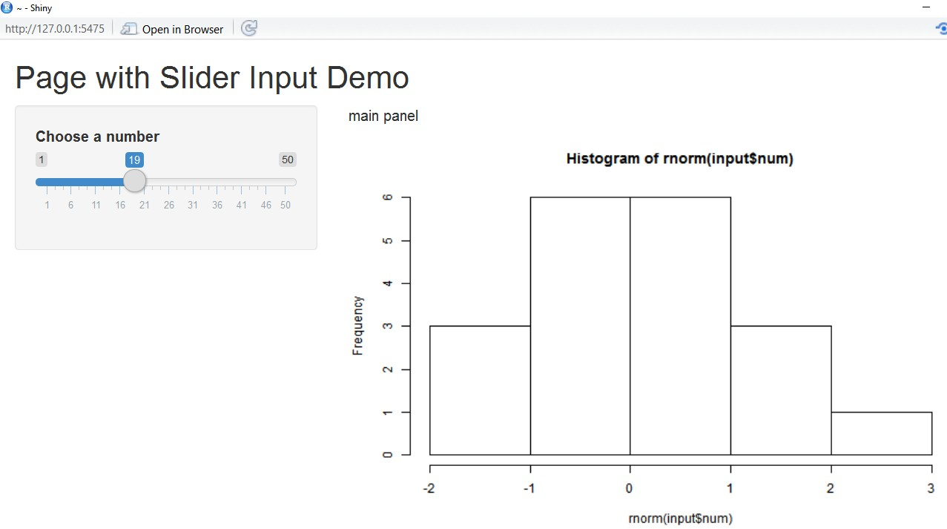
Exercise 4: Write the server function
library(shiny) ui <- fluidPage(
titlePanel("Page with Slider Input Demo"), sidebarLayout(
sidebarPanel(
sliderInput(inputId = "num",label = "Choose a number", value = 10, min = 1, max = 50)),
mainPanel("main panel", plotOutput("hist")
)
))
server <- function(input, output) {
output$hist <- renderPlot({ hist(rnorm(input$num))
})
}
shinyApp(ui = ui, server = server)

Slide 106
The two files app: ui.R and server.R
library(shiny)
# ui.R library(shiny) fluidPage(
titlePanel("Page with sidebarLayout( sidebarPanel(
ui <- fluidPage( titlePanel("Page sidebarLayout( sidebarPanel(
with
Slider
Input
Demo"),
Slider Input Demo"),
= "Choose a 50)),
sliderInput(inputId = "num",label number", value = 10, min = 1, max =
mainPanel("main panel", plotOutput("hist")
)
))
= "Choose a 50)),
sliderInput(inputId = "num",label number", value = 10, min = 1, max =
mainPanel("main panel", plotOutput("hist")
)
))
server <- function(input, output) {
output$hist <- renderPlot({hist(rnorm(input$num))
})
}
shinyApp(ui = ui, server = server)
32
# server.R library(shiny)
server <- function(input, output) {
output$hist <- renderPlot({hist(rnorm(input$num))
})
}

Slide 107

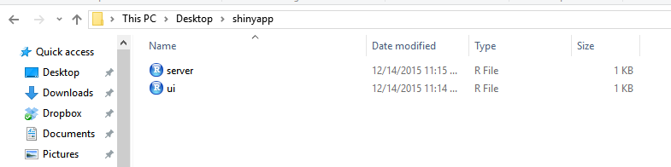
The two files app
One directory with two files:
server.R
ui.R
You MUST use the exact file names – server.R and ui.R

Slide 108
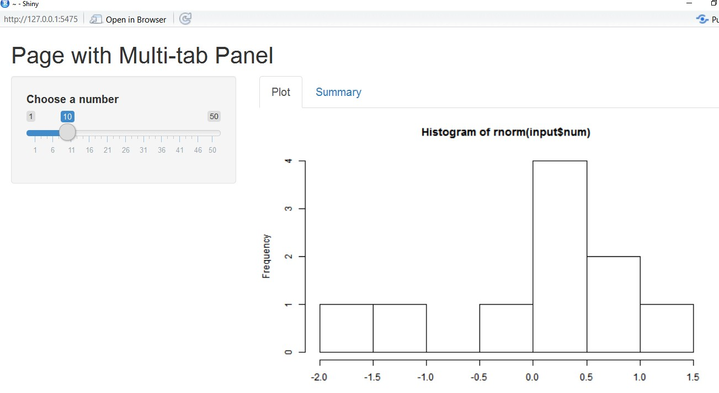
Exercise 5: Layout
library(shiny)
ui <- fluidPage(
titlePanel("Page with Multi-tab Panel"), sidebarLayout(
sidebarPanel(sliderInput(inputId = "num",label = "Choose a number", value = 10, min = 1, max = 50)
),
mainPanel( tabsetPanel(
tabPanel("Plot", plotOutput("hist")), tabPanel("Summary", verbatimTextOutput("summary"))
)
)))
server <- function(input, output) {
output$hist <- renderPlot({hist(rnorm(input$num))}) output$summary<-renderPrint({summary(rnorm(input$num))})
}
shinyApp(ui = ui, server = server)

Slide 109
Exercise 6: Reactive Shiny app
Download the Banting Air Pollutant Index file from https://raw.githubusercontent.com/gulstein86/shinyApp/master/API_Banting.csv
Note that the Air Pollutant Index file capture data by the hour from 01-08-2013 till 05-02-2015
Develop a shiny app to plot API reading by Year and Month
Sample Output: https://aswadi.shinyapps.io/banting_api_index/

